Slide 1
Gripper for PICKING UP THEboxes with no aid
(with all the range of dimensions taken in to account)

Slide 2
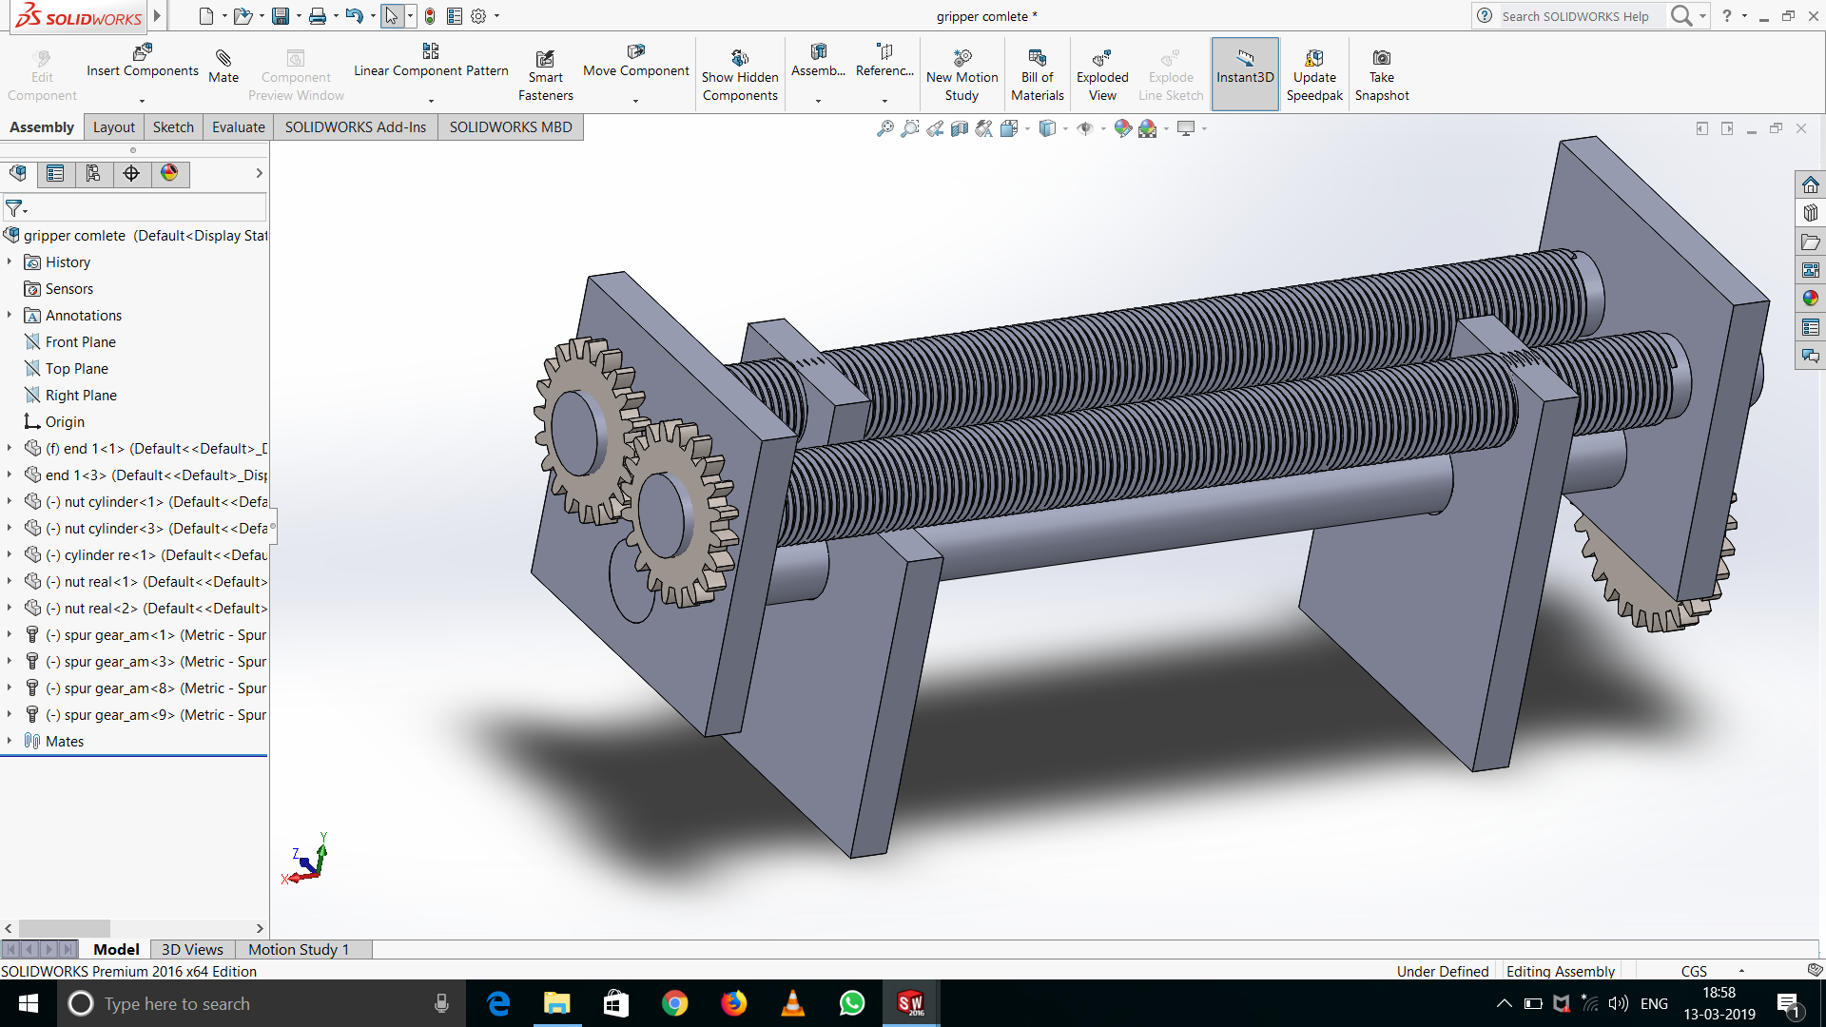
THE GAP BETWEEN THE TWO PLATES WILL BE ADJUSTED IN ORDER TO LOCK THE TARGETED BOX.

Slide 3
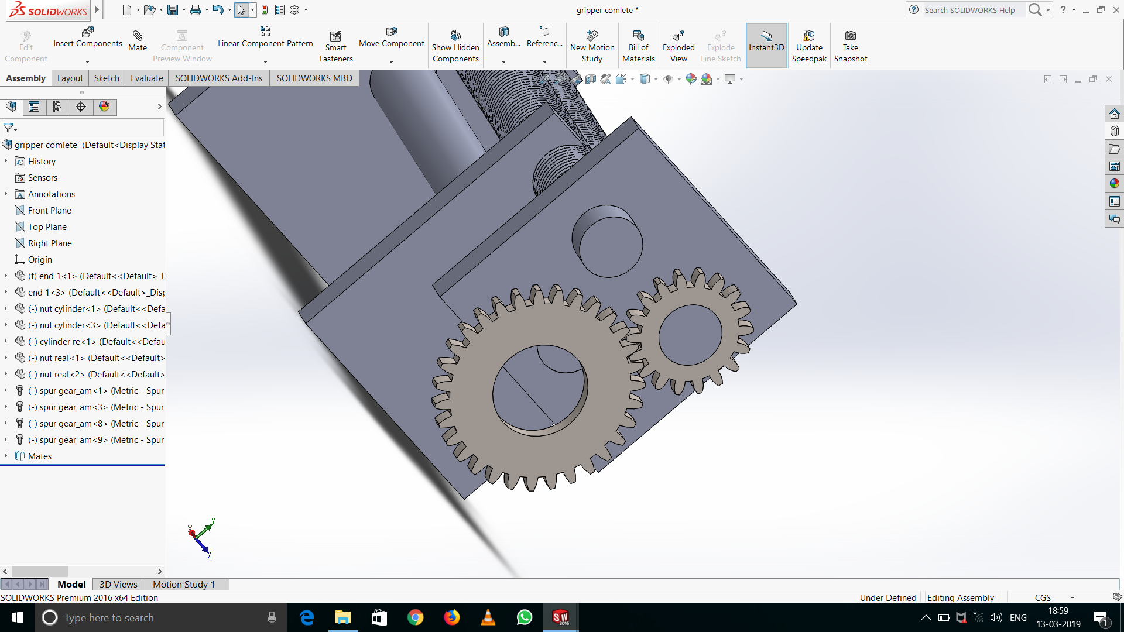
POWER IS TRANSMITTED TO THE GEARS BY SERVO BY THE BIG SPUR GEAR.

Slide 4
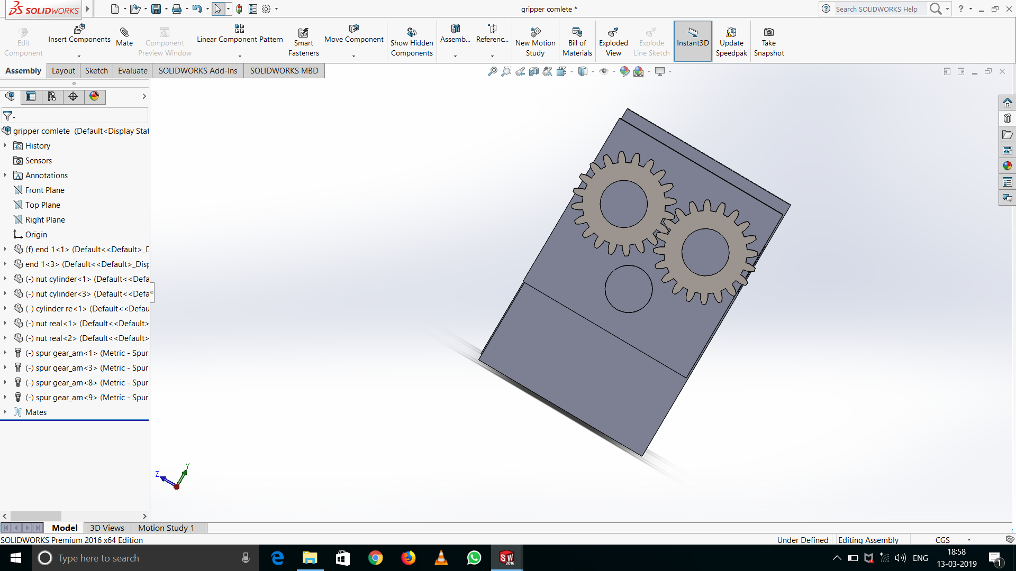
POWER IS TRANSMITTED TO THE OTHER GEAR ON THE OTHER SIDE OF THE SERVO WHICH IS SHOWN HERE.

Slide 5
ON THE OTHER SIDE OF THE SERVO WHERE TWO SPUR GEARS OF TWO SIMILAR DIMENSIONS ARE PRESENT.IN THIS SYSTEM THE CYLINDERS WHICH ARE THREADED WILL ROTATE IN DIFFERENT DIRECTIONS BY THE SYSTEM OF GEARS.
WITH THIS WE CAN CONCLUDE THAT THE PLATES MOVE IN OPPOSITE DIRECTION.
THIS WILL MAKE THE GAP TO INCREASE OR DECREASE.
ENDS ARE SUPPOSED TO BE ATTACHED TO THE QUADCOPTER.

Slide 6
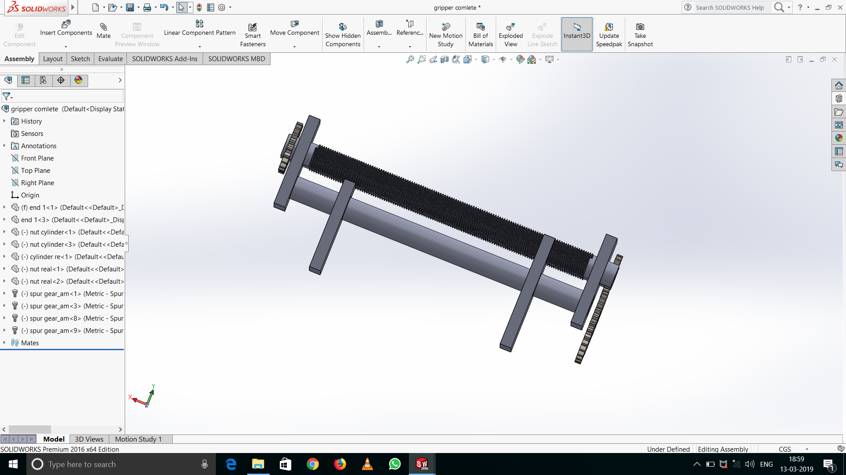
THE PLATES WILL SLIDE ON THE THIRD CYLINDER WHICH IS AT BOTTOM OF UPPER TWO CYLINDERS.

Slide 7
FRONT VIEW

Slide 8
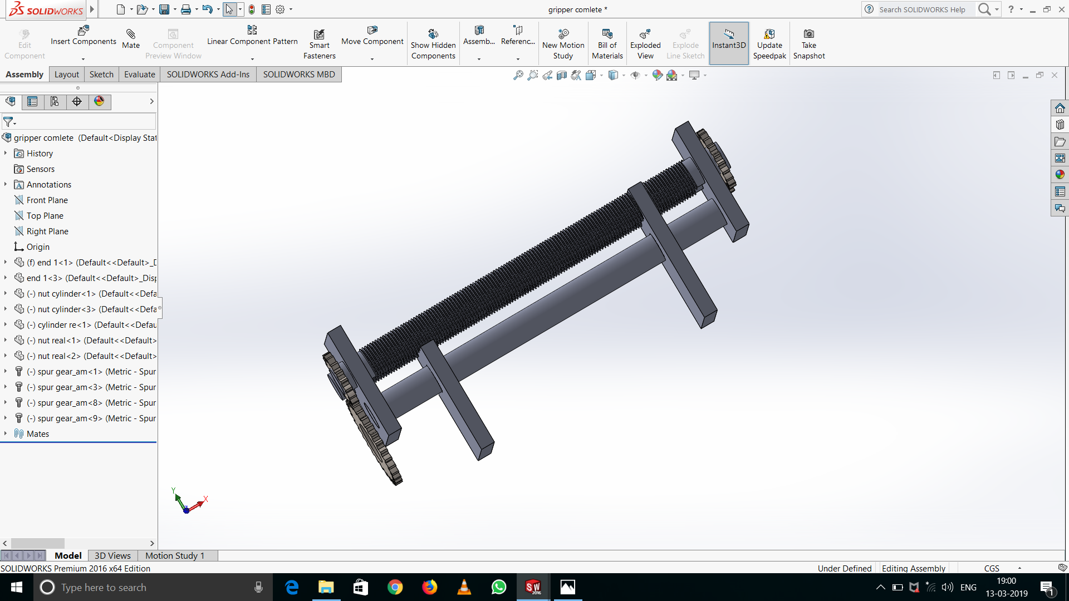
BACK VIEW

Slide 9
SENSOR REQUIRED
2 LASER POINTERS TO DETERMINE THE DISTANCE OF THE PLATE AND DISTANCE OF SIDE FACE OF THE BLOCK FROM IT.
I SUPPOSE TO INTRODUCE A CONDITON THAT (IF DISTANCE OF THE FACE OF THE BLOCK IS GREATER THAN THE DISTANCE OF THE PLATE + THICKNESS THEN SERVO ROTATE TO REDUCE THE DISTANCE.)

